Slide 1
Santander Customer Transaction Prediction
Presented by the team of:
Tommy Entwistle, Shaleen Swarup, Harshitha Kuriminisetty, & Koller Adzick
Notes:
Tommy -
Hello everyone and welcome to our presentation on Santander Customer transaction prediction from the team of Koller, Harshitha, Shaleen, and myself

Slide 2
Presentation Agenda
Background & Business Applications
Santander Customer Data & Exploration
Our Model & Solution Overview
Business Insights & Next Steps
Notes:
Tommy

Slide 3



Background
Santander’s Question - Which customers will make a transaction?
Our Goal - Create a model that will outperform their current model to efficiently find those most likely to make a transaction with Santander
Our Model
Notes:
Tommy
The data team at Santander is looking to predict which customers will be making a transaction in the future given certain variables.
The current model is a majority classifier with prediction accuracy of 90%.
This number is deceivingly high, due to class imbalance i.e. 90% of the data are labeled as non-purchasers, if you guess all data points as non-purchasers you’ll get 90% accuracy.
Santander is looking to measure AUC, which is a less misleading measure
(Click)
“As a way of background Santander Bank is looking to solve one of the oldest business issues, What customers do we target?
(Click)
So the task is simple, using a dataset of customer information from Santander we want to create a model that can predict which customers will make a transaction. A well designed model will help the business find the needles in the customer haystack and lead to greater return on their marketing investment.”

Slide 4


Business Applications
The goal is to predict what types of customers should be targeted for promotions and what new types of customers Santander should be targeting.
Unlike the original model, our model will be able to target the most likely purchasers ultimately aiming to decrease the waste in advertisement spend.
Notes:
Tommy
The model’s purpose is to predict what types of customers should be targeted for promotions and what new types of customers Santander should be targeting.
Their current model wastes advertisement spend. Because Santander doesn’t know who are the likely purchasers, they are implementing a blanket marketing strategy, distributing advertisements to everyone.
Our model will be able to target the most likely purchasers ultimately aiming to decrease the waste in advertisement spend.
“Santander will be able to use this model in order to get a better understanding of their customer base and what type of customers they should target in the future with their advertising and promotions.
This will also be important as the cost to acquire a customer through traditional channels in the banking industry is around $300. And lowering the cost to acquire a customer by targeting the right people will help Santander keep up with their competitors.
Next Koller will discuss the Santander customer data we were given to work with”

Slide 5
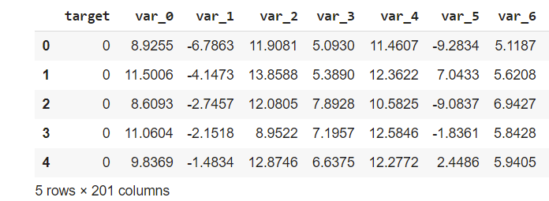
Santander Data Overview
Training data has 202 features (extra labeled feature), test has 201 features.
Labeled feature values are 0 (non-purchaser) and 1 (purchaser)
Features are named var_0, var_1, etc. so there is no context given outside of the data as to what they mean.
There are 200,000 rows in each dataset.
No missing values as the data has already been processed.
Notes:
Koller

Slide 6
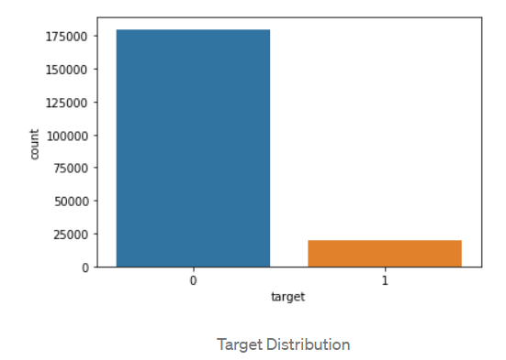
Exploration
Class imbalance
~90% of training data labeled 0 (non-purchaser) and ~10% labeled 1 (purchaser).
To avoid sacrificing information in the data, oversampling was chosen to deal with class imbalance, which if left unchecked, could result in a biased model towards the heavier balance.
Notes:
Koller

Slide 7
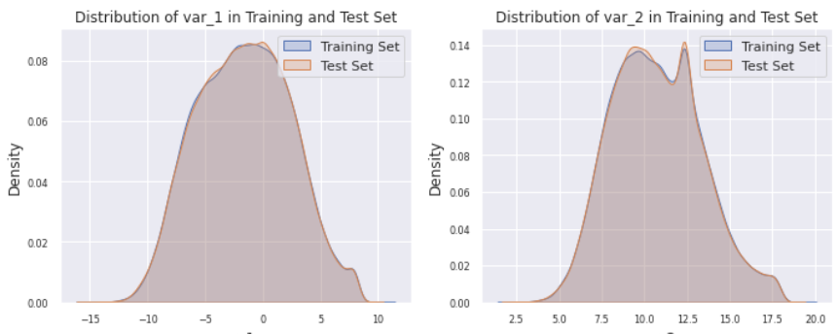
Exploration Continued
Training and testing variable distributions are almost identical.
Notes:
Koller - LigthGBM picks up on the little spikes well.

Slide 8
Feature Engineering - Fake Test Samples
The distribution of the number of unique values (across features) is significantly different between training set and test set.
Our research suggests that the test set consists of real as well as synthetic or fake samples that were generated by sampling the feature distributions of real samples (These samples are probably not used in the official scoring).
Rows that contain at least one unique feature value are real rows.
Rows that contain no unique feature values are likely synthetic.
Extract real samples from test data and combine with training data to create new features based on how many times values repeat themselves.
Notes:
The distribution of the number of unique values (across features) is significantly different between training set and test set.
Our research suggests that the test set consists of real as well as synthetic or fake samples that were generated by sampling the feature distributions of real samples
Rows that contain at least one unique feature value are real rows.
Rows that contain no unique feature values are likely fake.
Extract real samples from test data and combine with training data to create new features based on how many times values repeat themselves.
(The fake samples are probably not used in the official scoring and since we are using the test data to create new features, we had remove these).

Slide 9
Feature Engineering - Oversampling
Since the data is imbalanced we have oversampled the data. This increases our performance significantly as our model has more data to train on.
Target = 1 sample
Target = 1 shuffled samples
Target = 1 shuffled samples
Target = 1 samples
Increasing samples by 200%
Target = 0 samples
Target = 0 samples
Target = 0 shuffled samples
Increasing samples by 100%
Notes:
The samples which have a target variable of 1 have been increased by 300%. We shuffle the samples and add the them to the existing dataset. We do this twice for target variable 1.
similarly we increase target 0 samples by 200%.we shuffle the samples and add them once since it the dataset already consists of 90% target 0 samples.

Slide 10

Our Model
LightGBM
It differs from other tree based algorithm as focuses on accuracy of results.
‘Light’ because of its high speed and Supports GPU learning
Large size of data and takes lower memory to run.
With no feature engineering, evaluation on training/testing data yields about a 90% AUC score.
Notes:
The size of data is increasing day by day and it is becoming difficult for traditional data science algorithms to give faster results. Light GBM is prefixed as ‘Light’ because of its high speed. Light GBM can handle the large size of data and takes lower memory to run. Another reason of why Light GBM is popular is because it focuses on accuracy of results. LGBM also supports GPU learning and thus data scientists are widely using LGBM for data science application development.

Slide 11
Model Evaluation
Model | Hyperparameters | Best AUC Score
LightGBM | Combination 1 | 92.3%
LightGBM | Combination 2 | 92.1%
LightGBM | Combination 3 | 92.1%
Neural Network(CNN) | 4 layers | 89.2%
Naive Bayes | - | 89.6%
Santander Base Model | Majority Classifier | 50.0%
*Hyperparameter combinations available HERE

Slide 12
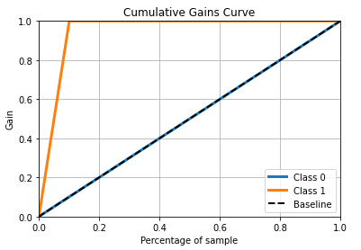
Business Insights
For santander, each transaction incurs a revenue of around $2, cost of advertising is $0.5.
By using CRC curve, you can target the customers you need to send the ads which is 10% of the total customers to get an Return of investment of 300%.
With our model, Santander should be able to more effectively target customers for their marketing campaigns, which will decrease ad spend and ultimately increase profits.

Slide 13
Summary & Conclusions
Our model can be used to find the right customers to target and increase profits, as well as return on marketing investment.
After dealing with data imbalance our data was ready for feature engineering.
Best Method - LightGBM which gives auc score of 92.3
Best Return on investment is around 300%.

Slide 14
Thank you!
Any Questions?

